Slide 1
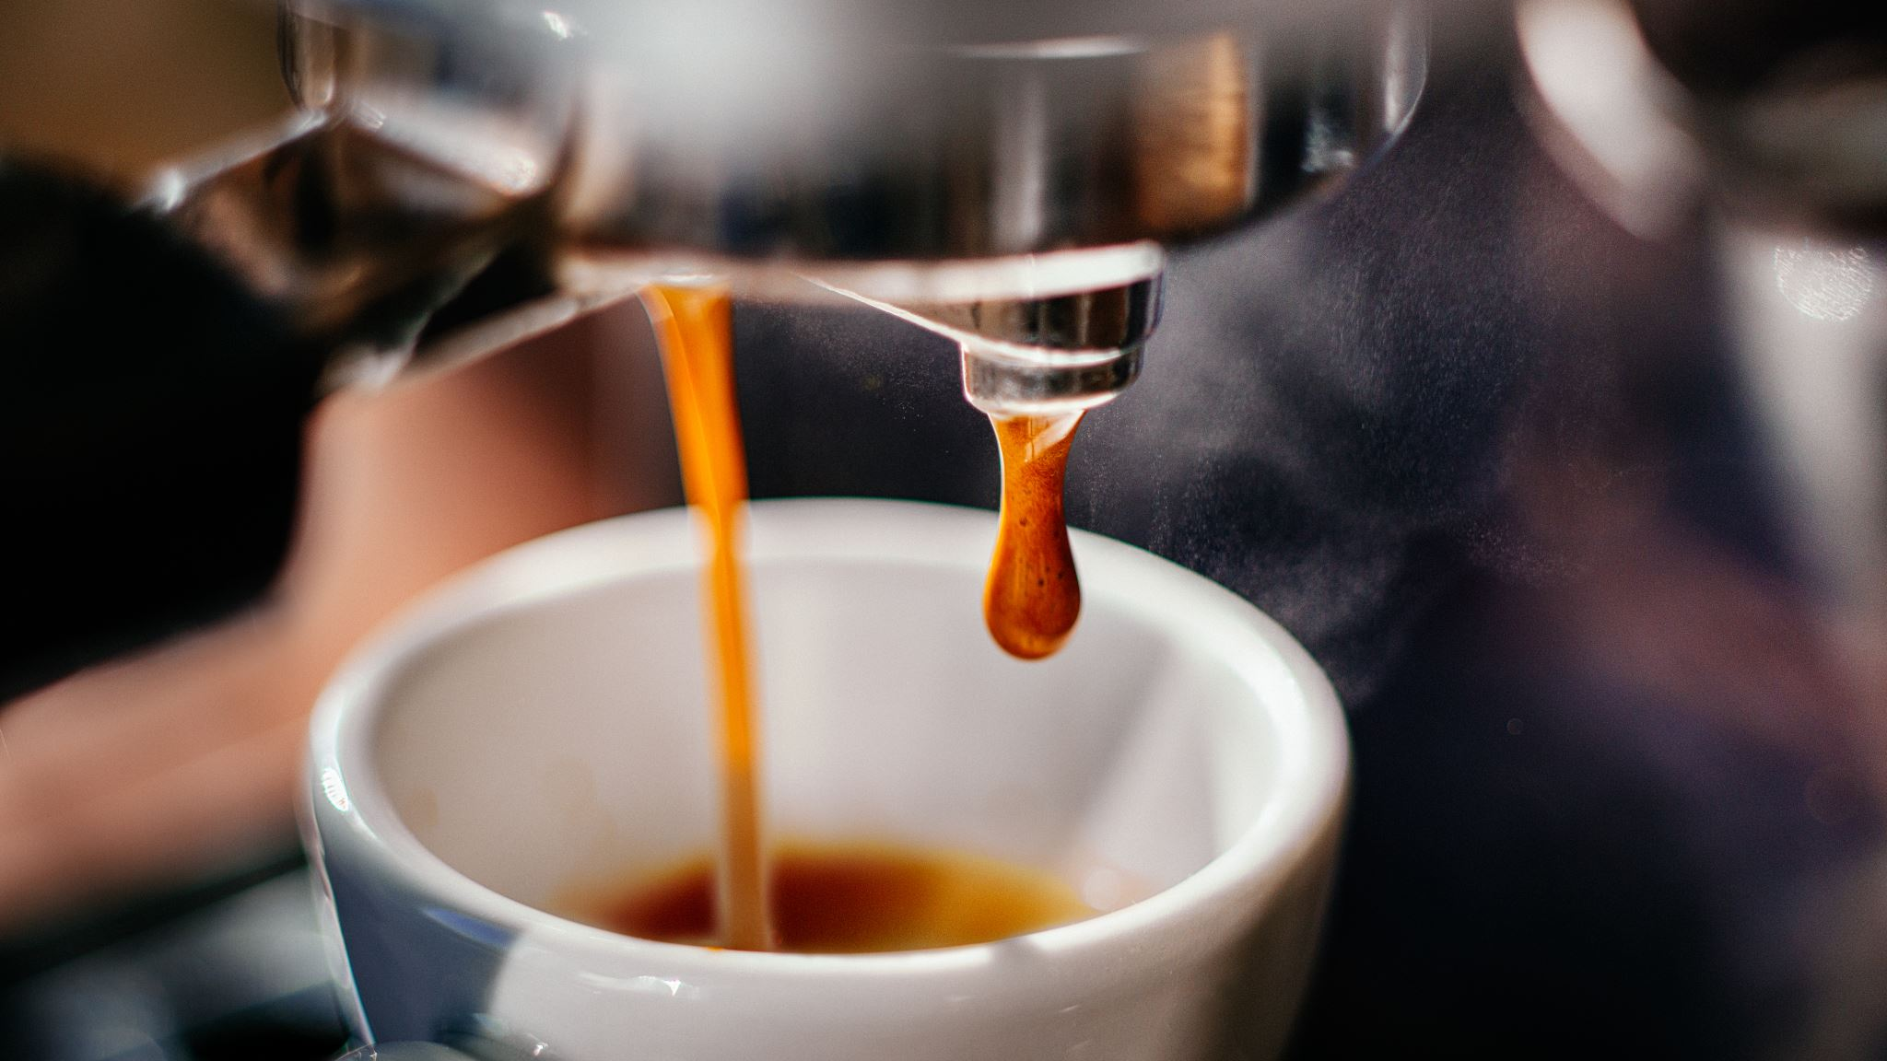
Bright Coffee Shop Sales Analysis
Lihle Sonjica

Slide 2
Total Revenue by Product Type
Barista Expresso generated the highest total revenue, followed by Brewed
Chai tea and Hot chocolate. These top products significantly outperform
Other types indicating strong customer preference for warm beverages.
Lower performing product types, such as green tea and organic chocolate
Contributed minimally to total revenue.

Slide 3
Total Revenue by Product Category
Coffee generates the highest revenue in all three locations, followed by Tea And Bakery.
Hell’s Kitchen slightly leads in Coffee and Coffee Beans revenue.
Lower Manhattan performs best in Bakery, Branded, Loose Tea, and Flavours.
Packaged Chocolate contributes the least revenue across all locations.

Slide 4
Peak Time Intervals
Morning accounts for the largest share at 56%
Afternoon follows with 29%
Evening has the smallest portion at 15%

Slide 5
Total Sales by Time of the Day and Store Location
Morning shows the highest sales for all stores, with Lower Manhattan leading.
Afternoon sales are moderate, with Astoria performing best.
Evening sales are the lowest overall, with Astoria again slightly ahead.
Mornings are the strongest sales period across all locations.

Slide 6
Total Sales by Months
The trend of total sales from January to June.
Sales slightly decline in February, then steadily increase from March onwards, peaking in June at just above 50,000 units.
Overall, there is a consistent upward trend in total sales during the six-month period.

Slide 7
Total Revenue by Months and Store Location
This clustered bar chart compares monthly revenue from January to June across three store locations: Astoria, Hell’s Kitchen, and Lower Manhattan.
Revenue slightly dips in February but increases steadily from March, peaking in June at around R55,000 for all locations.
Hell’s Kitchen consistently records the highest revenue, followed closely by Astoria and Lower Manhattan.

Slide 8
Total Revenue by the Day of the Week
This line chart shows trends from Sunday to Saturday.
Revenue peaks on Monday and again slightly on Friday, while Saturday records the lowest revenue.
Overall, revenue remains relatively stable during the week with minor fluctuations.

Slide 9

Recommendations
Since most customer activity (56%) occurs in the morning, increase morning capacity by ensuring sufficient staff and stock availability during this period to maximize sales.
Boost afternoon and evening traffic by launching targeted marketing campaigns or special promotions (e.g., discounts or loyalty rewards) during slower time slots to drive customer engagement and balance traffic throughout the day.
Optimize product mix by prioritizing inventory for high-performing products like Coffee, Tea, and Bakery items to meet demand efficiently.
Promote Underperforming Categories introduce bundle deals or limited-time offers to increase sales of low-performing items such as Packaged Chocolate.
Leverage location strengths by tailoring product focus per store - emphasize Coffee at Hell’s Kitchen and Bakery at Lower Manhattan to capitalize on each location’s strengths.

Slide 10

Conclusion
Overall, the analysis shows strong business performance with steady sales growth from January to June and peak customer activity in the mornings.
Coffee, Tea, and Bakery items are the main revenue drivers across all stores, while Packaged Chocolate remains the weakest performer.
Among locations, Hell’s Kitchen leads in overall revenue, followed closely by Astoria and Lower Manhattan, which excels in specific product categories.
The findings suggest that the business is on a positive growth trajectory but could further improve performance by enhancing sales during slower time slots and promoting underperforming products to achieve a more balanced revenue distribution.

